Slide 1

University of Central Florida COP 3330 Object Oriented Programming

Slide 2
Graphical User Interface

Slide 3
JComponent
Except for the three top-level containers, JFrame, JDialog, and JApplet, all Swing components whose names begin with "J" descend from the JComponent class
JPanel
JScrollPane
JButton
JTable

Slide 4
JComponent
Tool tips
By specifying a string with the setToolTipText method
When the cursor pauses over the component, the specified string is displayed in a small window that appears near the component.
Painting and borders
The setBorder method allows for setting the border displayed around its edges
To paint the inside of a component, override the paintComponent method
Application-wide pluggable look and feel
JComponent descendants have a ComponentUI object that performs all the drawing, event handling, size determination, and so on for that Jcomponent relative to the current look and feel
Set using the UIManager.setLookAndFeel method
Custom properties
Associate one or more properties (name/object pairs) with any Jcomponent
put and get properties using the putClientProperty and getClientProperty methods

Slide 5
JComponent
Support for layout
JComponent class adds setter methods setMinimumSize, setMaximumSize, setAlignmentX, and setAlignmentY
Support for accessibility
JComponent class provides API and basic functionality to help assistive technologies such as screen readers get information from Swing components
Support for drag and drop
The JComponent class provides API to set a component's transfer handler, which is the basis for Swing's drag and drop support
Double buffering
Double buffering smooths on-screen painting
Key bindings
This feature makes components react when the user presses a key on the keyboard.

Slide 6
Text
Swing text components display text and optionally allow the user to edit the text
Use text components for guidance to the user
Swing provides six text components
JTextField
JFormattedTextField
JPasswordField
JTextArea
JEditorPane
JTextPane

Slide 7
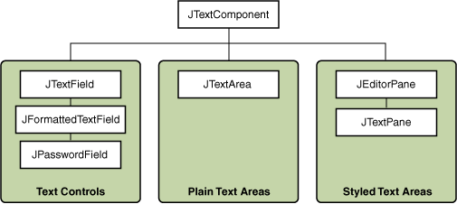
Text

